Slide 1
Keshav Kumar
TGA March 2023

Slide 2
Goldman Sachs - IMD onboarding Tech Stack
Java 8
Spring Boot
Kafka
Kubernetes
Gitlab
Mongo DB
MySQL
Redis
Prometheus
Angular
Apache Geode
Sonar
Cucumber
AWS

Slide 3
Introduction
Case Study: PS Martek – A POS Market Place
• PSMartek, a PS market platform,
• wants to build Automated innovative online POS systems that cater to retail fashion stores
• aiming to handle 1K orders per Sec,
• capable of scaling to 50K transactions per sec within a year.
• PS would like to offer this to its clients as monetized services for its clients on a pay-as-you-go model.
• We should be able to onboard multiple clients/ stores as we scale up. This needs to be highly efficient.
• As a customer, you can scan a barcode and proceed with billing after trying the cloth of your choice.

Slide 4
Workflow
1. Enter the store
2. Download the app & Register / Login
3. Try different dresses
4. found fit, scan the QR / Barcode
5. checkout
6. payment
7. Order Summary
8. To be delivered to the delivery address
9. Walk out of the store carrying nothing.

Slide 5
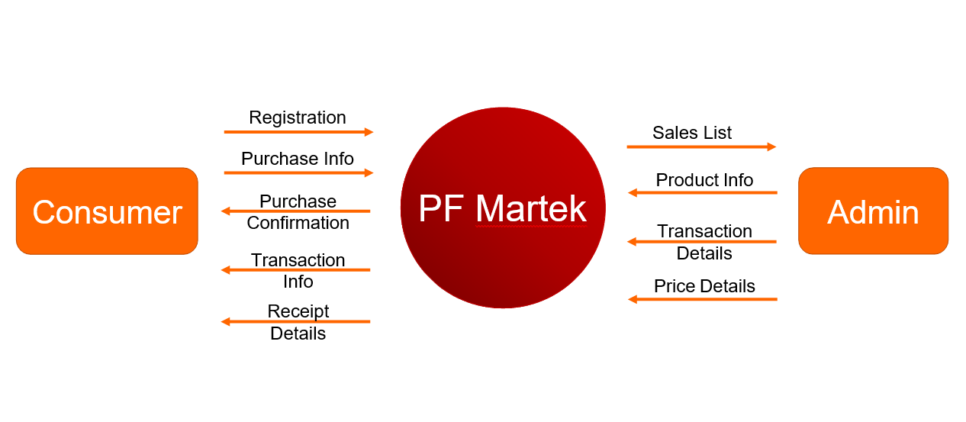
Level 0 Data Flow Diagram

Slide 6
High Level Logical Architecture
AWS INFRASTRUCTURE
App/Website
API GATEWAY
Single Sign-on
Async/ events
CORE MICROSERVICES
Product
Order
Customer
Cart
Inventory
Payment
Search
Realtime/ APIs
IDENTITY & ACCESS MANAGEMENT
Batch/ feeds
OAUTH
Notification
Shipping
DATA & INSIGHTS AS A SERVICE
Service to service
DATA STORES
(Account, Activity, Product, Loyalty etc. )
INSIGHTS
REPORTING/ DASHBOARDING
Service Mesh (Monitoring , Security, Service to Service communication)
Notes:
Not included:
Voice skills
Customer Data Platform

Slide 7
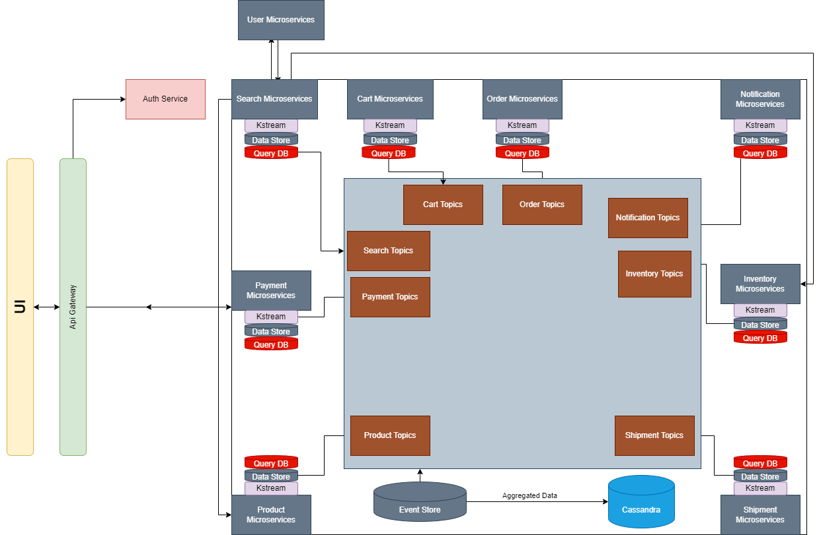
Architecture Diagram

Slide 8
Agile Execution Process
Ongoing prioritization and building of the solution for continuous delivery
Deployable Code
Testing
UAT & Training
1
Update Product Backlog
High level scope
Epics
Initial list of User Stories
2
Backlog Refinement
Detail User Stories
Add Acceptance Criteria
Estimate User Stories
Rank User Stories (by business value)
3
Sprint Planning
Define Sprint Goal & sprint backlog
Decide Sprint Scope (based on Velocity)
Sprint Plan creation
4
Sprint Backlog
Contains Scoped PBI (Product Backlog Item) in a Sprint
Detailed Plan to achieve Sprint goal
5
Time Boxed Sprint
Complete Development & Unit Testing
Demo (Internal & Business)
P1/P2 Defect Fixing (in parallel)
Sprint Retrospection
Go Live ready code
6
Testing
Holistic testing of release
Non-functional testing of the platform
Complete system integration tests
7
UAT and Training
Business execute UAT test cases
Dev team fix issues raised by business in parallel
Training provided to additional business / end users
Create pipeline of “ready” stories with creative, functional, technical requirements, with clearly defined acceptance criteria
Team picks up “ready” stories and implements them to “done” state
Readiness activities start at least 2 sprints earlier

Slide 9
Artifacts
Working Codebase - MVP
Kafka implementation
RDBMS implementation (MySQL DB)
NoSQL(Mongo DB)
Cloud setup in local (Docker, Kubernetes Minikube,Helms)
Code Quality and Testing Framework (Unit Testing, Integration Test, BDD Cucumber)
Swagger Open API Specification

Slide 10
Architecture Characteristics
Beyond functional requirements, architecture must support other operational, structural and cross-cutting architectural characteristics (aka –ilities)
Any choices made for software, frameworks and patterns shall not negatively impact any of the above
These characteristics essentially formulate the non-functional requirements. These shall be detailed (what each of them means) in later phases
Key highlights
Detailed operational, structural and cross-cutting characteristics
Operational characteristics
Availability
Performance
Scalability
Robustness
Structural characteristics
Configurability
Localization
Upgradability/ Maintainability
Flexibility and Extensibility
Cross-cutting characteristics
Accessibility
Security
Usability
Legal/ compliance (e.g., GDPR)
Agility/ Adaptability

Slide 11
Design Patterns Used
CQRS(Command Query Responsibility Segregation)
Domain Driven Design
Database Per Service
SAGA Choreography Pattern
API Gateway Pattern
Circuit breaker pattern

Slide 12
Testing
SonarQube Jacoco Plugin – for static code analysis, finding code smell, vulnerability
Unit testing - Junit, Mockito
Integration Testing – Mock Mvc
Function testing – BDD Cucumber
QA Testing – Automation testing Selenium
Performance Testing – JMeter –Throughput , load testing
UAT – old device, browser compatibility, device comparison
Penetration testing – Man in the middle attack, HTML vulnerability, SQL query injection, DDOS attack – Rate Limiter

Slide 13
NFR
Scalability: Horizontal scaling, load balancing, auto-scaling, stateless services, asynchronous communication, caching - Event sourcing, Load Balancer, Horizontal Pod Autoscaling
Availability: Fault tolerance, redundancy, monitoring, and alerting - Multiple replicas of services and database, Prometheus and Grafana for monitoring and alerting , Circuit breaker for fault tolerance, Release management with different versions of services
Reliability: Testing, quality assurance, error handling, logging, tracing, and rollback strategies) – Test Driven Development, Automated Testing, CICD for integration, distributed log tracing using zipkins, versioning of services for rollback

Slide 14
NFR
Performance : Optimization, caching, data compression, load balancing, and efficient resource utilization – Redis, load balancer, Amazon S3 for static content as images, HTML, CSS, Data compression
Security (Authentication, authorization, encryption, network security, and compliance with security standards and regulations.) – Token based access , Role based access, JWT, OAuth, masking of sensitive data as card details of user, IAM
Maintainability: Modularity, loose coupling, versioning, documentation, and continuous integration and deployment) – CICD using pipelines, Event based communication and rest api calls , versioning of API, Swagger , Confluence

Slide 15
Database Management
Create multiple replicas of database for failover
Archive transactional data like order, payment after certain period like 30 days after order flow is completed.
SQL and NoSQL database
Caching of data

Slide 16
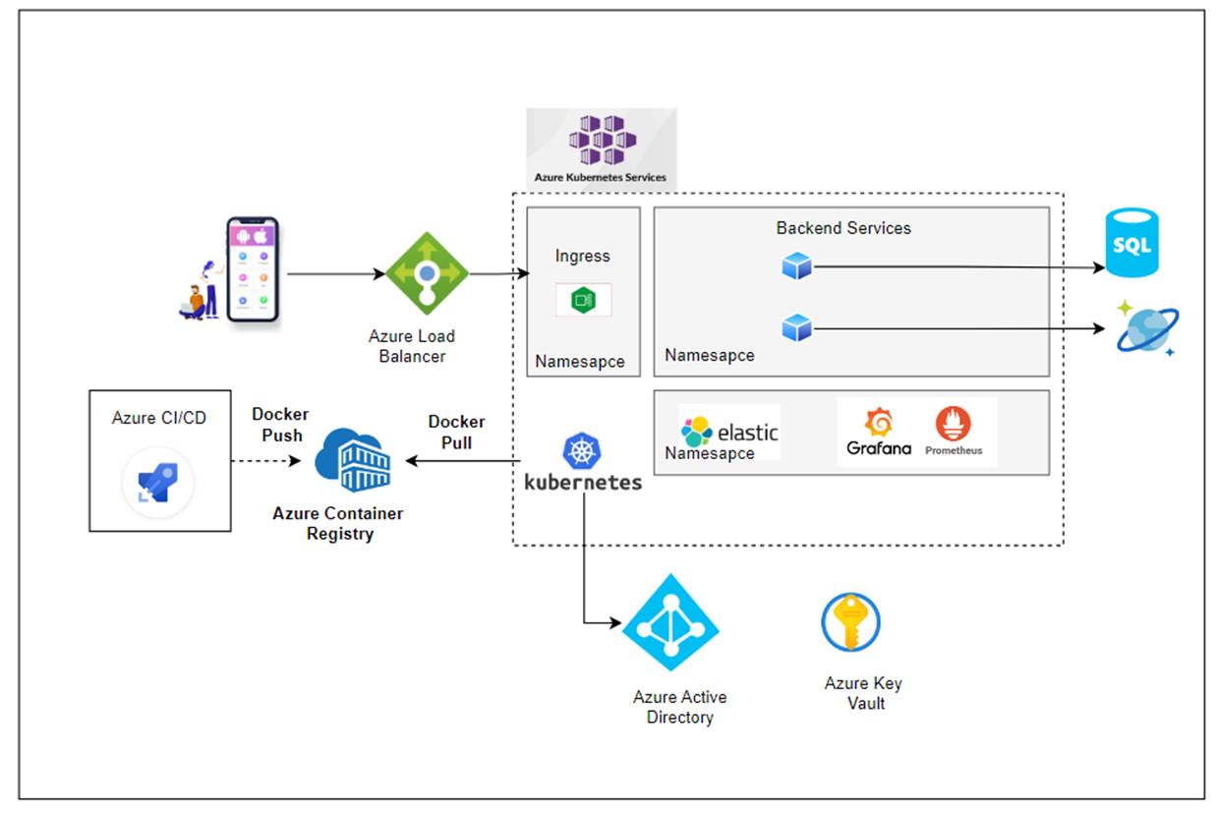
Cloud Deployment

Slide 17
ELA and EMM
•ELA a set of processes with some KPI - which defines how well developed the system is and if it can give repetitive results , which can then be automated to get a guaranteed output
•ELA Metrics are used to determine the quality, health & level of governance
•ELA Metrics are divided into few metrics, as shown below

Slide 18
ELA continued
•Project Metrics – Can be extracted from the Confluence/JIRA, as part of DOJO tool integration e.g. Sprint Velocity, Sprint Capacity Utilization
•Engineering Metrics – These Metrices reflect the quality of code, testing & build E.g. Sonar Bugs , First time pass rate , Test Case Coverage
•Speed KPIs – An additional Set of Metrices, focusing on rate of quality ,which is followed by PS for its client. E.g. Mean time to Merge, Code Build Time, Average Resolution time.

Slide 19
EMM- Levels of Maturity
Engineering Maturity Model is designed and adopted by Publicis Sapient as an initiative for people to measure and align on set of high bar Engineering KPI’s. It aims to generate right behavior in the teams (to engineers, architects and project leadership) with visual/measurable score highlighting where the gap is, and thus actively keep on improving the technology and engineering across the products/capabilities.
PS KnowHow has the tools, with the set of questionnairee, which can be updated quarterly/monthly. This will give a Maturity Model for the project .
Following are the key 4 "Engineering Transformation Areas" around which EMM is designed and respective accounts/projects will be measured and monitored continuously for excellence.

Slide 20
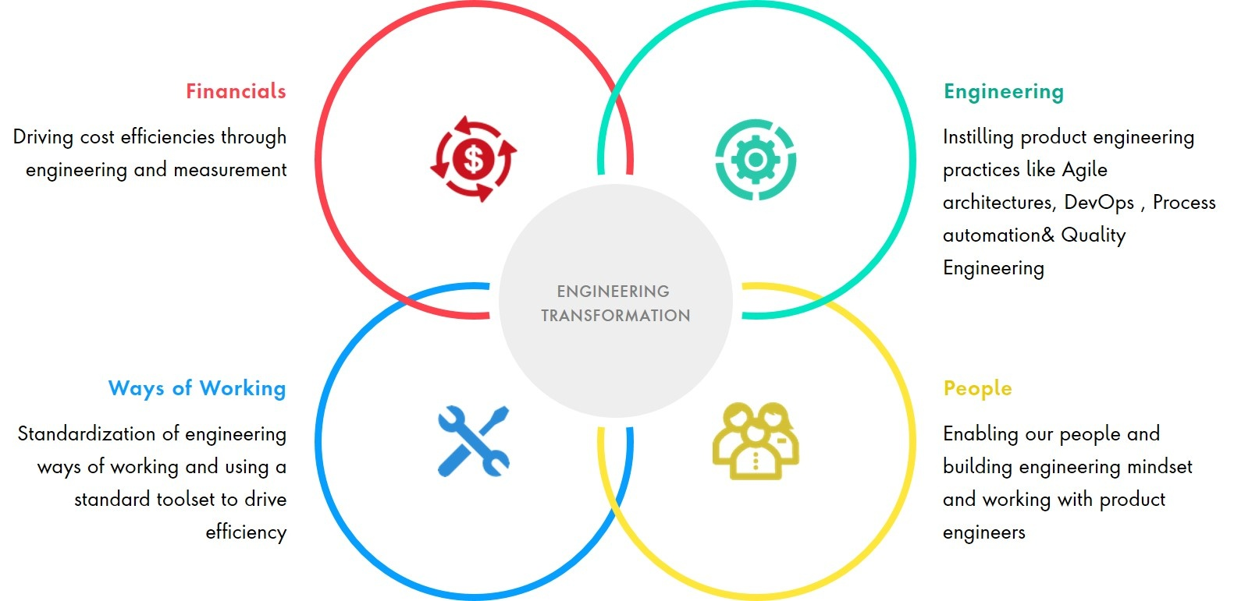
EMM

Slide 21
CMM- Capability maturity model
Level 1 - Initial: At this level, processes are often ad hoc and chaotic. There is no formalized process, and success depends on individual effort and heroics.
Level 2 - Managed: Organizations at this level begin to establish basic project management processes. Project management practices become more formalized, and there is an emphasis on planning, tracking, and controlling project activities.
Level 3 - Defined: At this level, organizations have well-documented and standardized processes for both project management and development. Processes are institutionalized and consistent across the organization.
Level 4 - Quantitatively Managed: Organizations at this level use quantitative data and metrics to manage and control their processes. There is a focus on continuous process improvement based on quantitative analysis.
Level 5 - Optimizing: The highest level of maturity, Level 5 organizations are continuously focused on process improvement. They use advanced techniques and technologies to improve processes and achieve maximum efficiency.

Slide 22
URL :
https://tools.publicis.sapient.com/bitbucket/projects/TGAB/repos/keshav-kumar/browse
https://tools.publicis.sapient.com/confluence/display/TGAB/POS+Architecture

